Slide 1
The Policies and Politics of Achieving Health Equity
Ram Raju, M.D
Introduction to Social Determinants of Health
Week Two

Slide 2
Go around the class – every one says their name, name something nonmedical they do to stay well and avoid the health care system

Slide 3
Overview

Slide 4
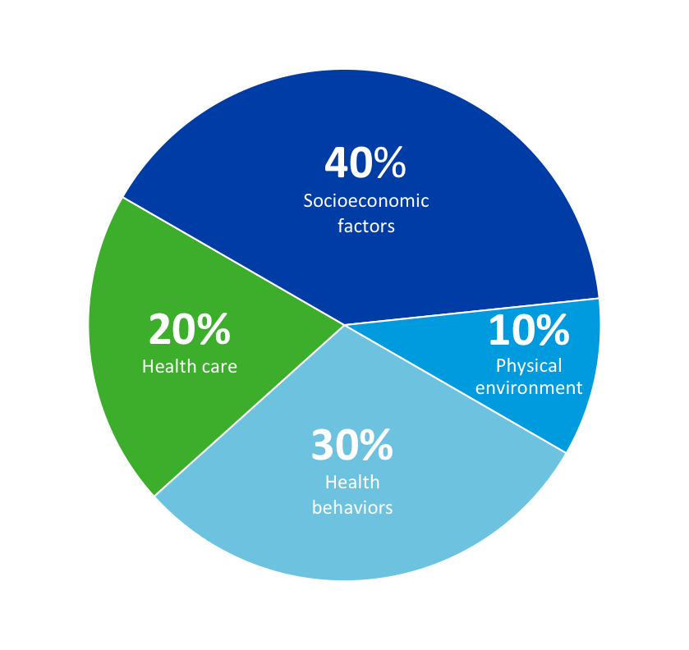




To improve health outcomes, we must see the whole picture
Social determinants of health are critical components of the health of populations
Socioeconomic factors
– Community safety
– Education
– Employment
– Family/social support
– Income
– Poverty
– Violence/domestic violence
Physical environment
– Built environment
– Environmental quality
– Housing/homelessness
– Transportation
Health behaviors
– Alcohol use
– Diet & exercise
– Food insecurity/hunger
– Tobacco use
– Unsafe sex
Health care
– Access to care
– Quality of care
Source: Analysis and adaptation from the University of Wisconsin Population Health Institute’s County Health Rankings model ©2010
http://www.countyhealthrankings.org/about-project/background

Slide 5
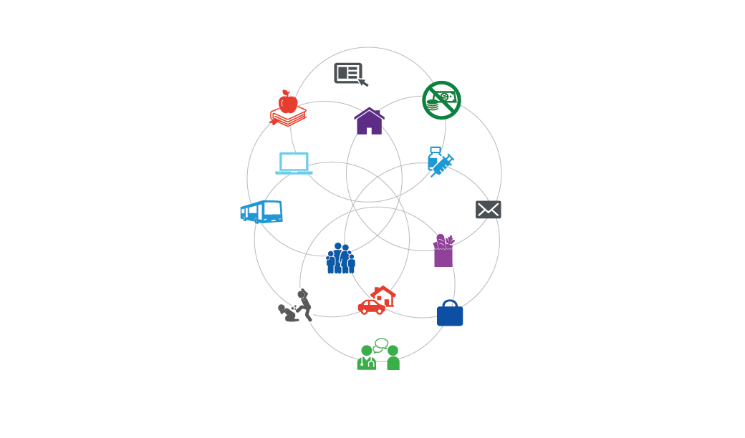


Our transformative journey…
The shift from fee for service to value-based care requires a broader view. As reimbursement
evolves, providers are encouraged to find new ways to deliver the best care at the lowest cost.
Education
Poverty
Housing/homelessness
Total health organization
Health care
delivery system
Clinical & business integration activities
Clinical care excellence
Transportation
The health of populations
Food insecurity/hunger
Violence/domestic violence
Employment
“The 20%”
“The 80%”
100%
October 2017

Slide 6


Key Steps to Advancing Health Equity
1.
2.
Create change to eliminate inequities in opportunities & resources needed to be as healthy as possible, including:
Policies
Laws
Systems
Environments
Practices
Identify important health disparities that are of concern to key stakeholders, especially those affected.
Identify social inequities in access to the resources and opportunities needed to be healthier that are likely to contribute to health disparities.
The Goal:
EQUITY in health and its determinants.
4.
3.
Reassess strategies to plan next steps.
Evaluate & monitor efforts using short-term and long-term measures.
Source: What is Health Equity? And What Difference Does a Definition Make?, UCSF & Robert Wood Johnson Foundation Report, May 2017

Slide 7
Discuss assigned readings

Slide 8
Summary of assigned readings

Slide 9
Closing the gap in a generation: Final Report of the Commission on Social Determinants of Health (CSDH; WHO 2008)
Health inequity impacts rich and poor countries and is created by not addressing the social determinants of health (SDH) – conditions in which people are born, grow, live, work, and age.
Health inequity addressed by:
  improving the conditions of daily life,
  tackling the inequitable distribution of power, money, and resources, and
  measuring the problem, evaluate action, expand the knowledge base, develop workforce that is trained in the social determinants of health, and raise public awareness about SDH
Health equity needs to be addressed by all stakeholders -- government, civil society, local communities, business and international agencies.
WHO’s two core strands of health equity:
  Improving the average health of countries
  Abolishing avoidable inequalities in health within countries
    Inequalities in social status → Inequalities in population health status

Slide 10
Achieving health equity: From root causes to fair outcomes. (Marmot; Lancet 2007)
Just or fair health needed to help nations avoid living with levels of ill-health that are preventable to achieve goal.
Global inequalities in health can be reduced through:
  Improvements in living and working conditions between & within countries
  Finding ways to deliver known medical solutions between & within countries.
Globalization helped achieve health equity through acceleration of:
  Trade, knowledge and resources flow
Health is a worldwide human goal and a fundamental human need.
The level of societal development, rich or poor, can be assessed by:
  Population’s health
  How fairly health is distributed across the social spectrum
  Degree of protection provided from disadvantage due to ill-health
Establishing “Health Equity” across nations, means exceeding the present day focus on immediate causes of disease.
Need to shift focus on the “causes of the causes” -- the fundamental structures of social classes and SDH.
Just or fair health needed to help nations avoid living with levels of ill-health that are preventable to achieve goal.
Global inequalities in health can be reduced through:
  Improvements in living and working conditions between & within countries
  Finding ways to deliver known medical solutions between & within countries.
Globalization helped achieve health equity through acceleration of:
  Trade, knowledge and resources flow
Health equity
is key

Slide 11
Health Policy Brief: The relative contribution of multiple determinants to health outcomes (McGovern et al; Health Affairs 2014)
Small share of health expenditures (< 9 %) devoted toward disease prevention
Very low investments in social services, including:
  Support services for older adults, survivors benefits, disability and sickness benefits, Family supports, Housing programs, Employment programs, Unemployment benefits
5 major classifications of health determinants
  1. Genetics 2. Behaviours 3. Social circumstances
  4. Environmental and physical influences
  5. Medical care
Social determinants: "the conditions in which people are born, grow, live, work and age, and which are shaped by the distribution of money, power and resources at global, national and local levels," and are "mostly responsible for health inequities."
Health in all policies (HiAP) approach promotes population health. Elements include:
  Promoting health, equity, and sustainability;
  Supporting intersectoral collaboration;
  Benefiting multiple partners (e.g., policies that improve health & benefit nonhealth partners);
  Engaging stakeholders; and
  Creating structural or process change.
Early childhood investments offer a promising cross-cutting solution to many social determinant pathways.
  Environmental and social factors that can influence behavior over the life course, beginning before birth.
Causes of poor US health outcomes

Slide 12
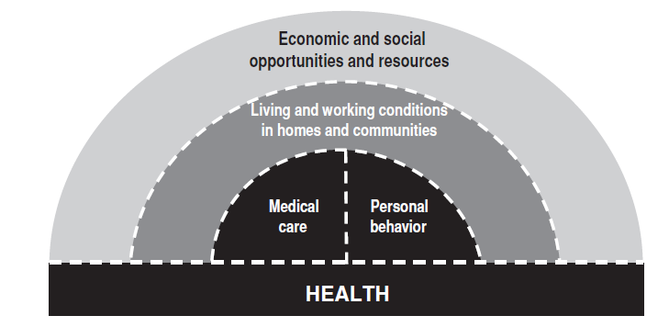
The Social Determinants of Health: Coming of age. (Braveman et al; ARPH 2011)
We know social factors are important influences on health, need to better understand how social factors operate and how we can design interventions.
Too little attention given to upstream social determinants of health – economic resources, education, and racial discrimination.
Upstream determinants represent the fundamental causes in pathways that influence downstream factors and ultimately lead to health effects.
Unrealistic to expect a single research study can encompass an entire pathway from upstream factor to downstream health effects.
  Complex causal chains & long time periods involved.
  Focus instead on advancing knowledge of pathways incrementally by linking results from studies of specific pathway segments.
Isolated interventions focused on single discrete (upstream or downstream) social factors may not be effective.
Challenge is to design and study multidimensional interventions that address multiple factors simultaneously.
Crucial barrier to addressing SDH in US is often lack of political will.

Slide 13
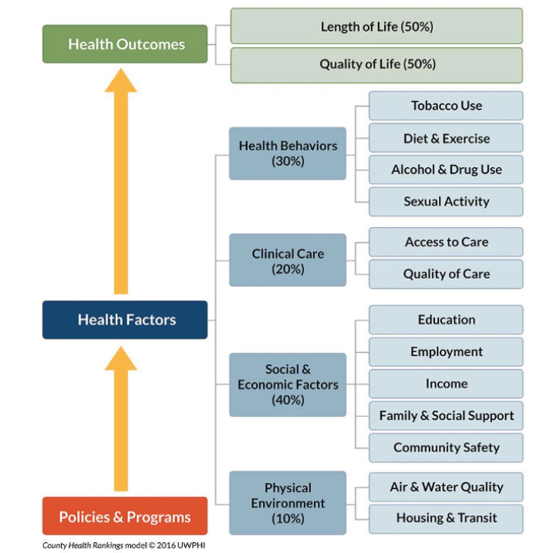
Social determinants of health 101 for health care. (Magnan; NAM 2017)
5 things we know about SDH in health care
  As a determinant of health, medical care is insufficient for ensuring better health outcomes
  SDH are influenced by policies and programs, and associated with better health outcomes
  New payment models are prompting interests in the SDH
  Frameworks for integrating SDH are emerging
  Experiments are occurring at the local and federal level.
5 things to learn about SDH in health care
  How do we prioritize SDH for individual patients and for communities
  How do we intervene without medicalizing SDH
  What new data are needed?
  How do we build multisector partnerships?
  What else?
    Population health and its measures.

Slide 14
Small Group Discussions

Slide 15
Discussion
What are the primary determinants of health in your lives?
What (if any) are the differences between social determinants of health and socially determined health inequities (as discussed last week)?
Who should address social determinants of health?

